Slide 1



Global Education Policy Dashboard
[COUNTRY’S NAME] - Presentation
2022

Slide 2
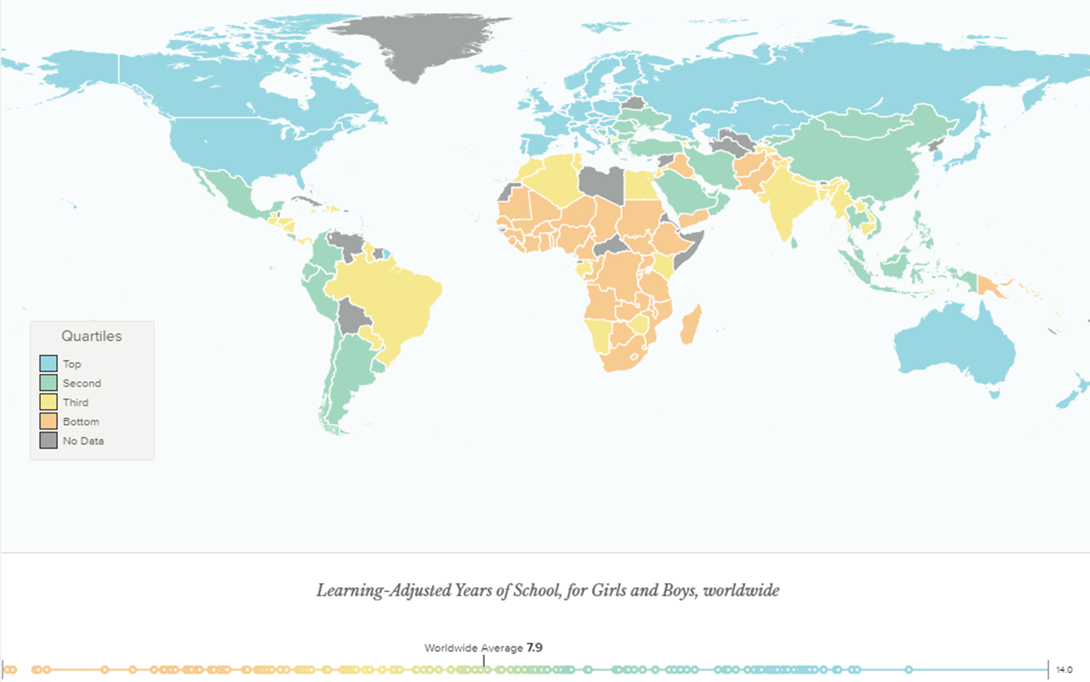
Learning disparities exacerbate schooling gaps

Slide 3
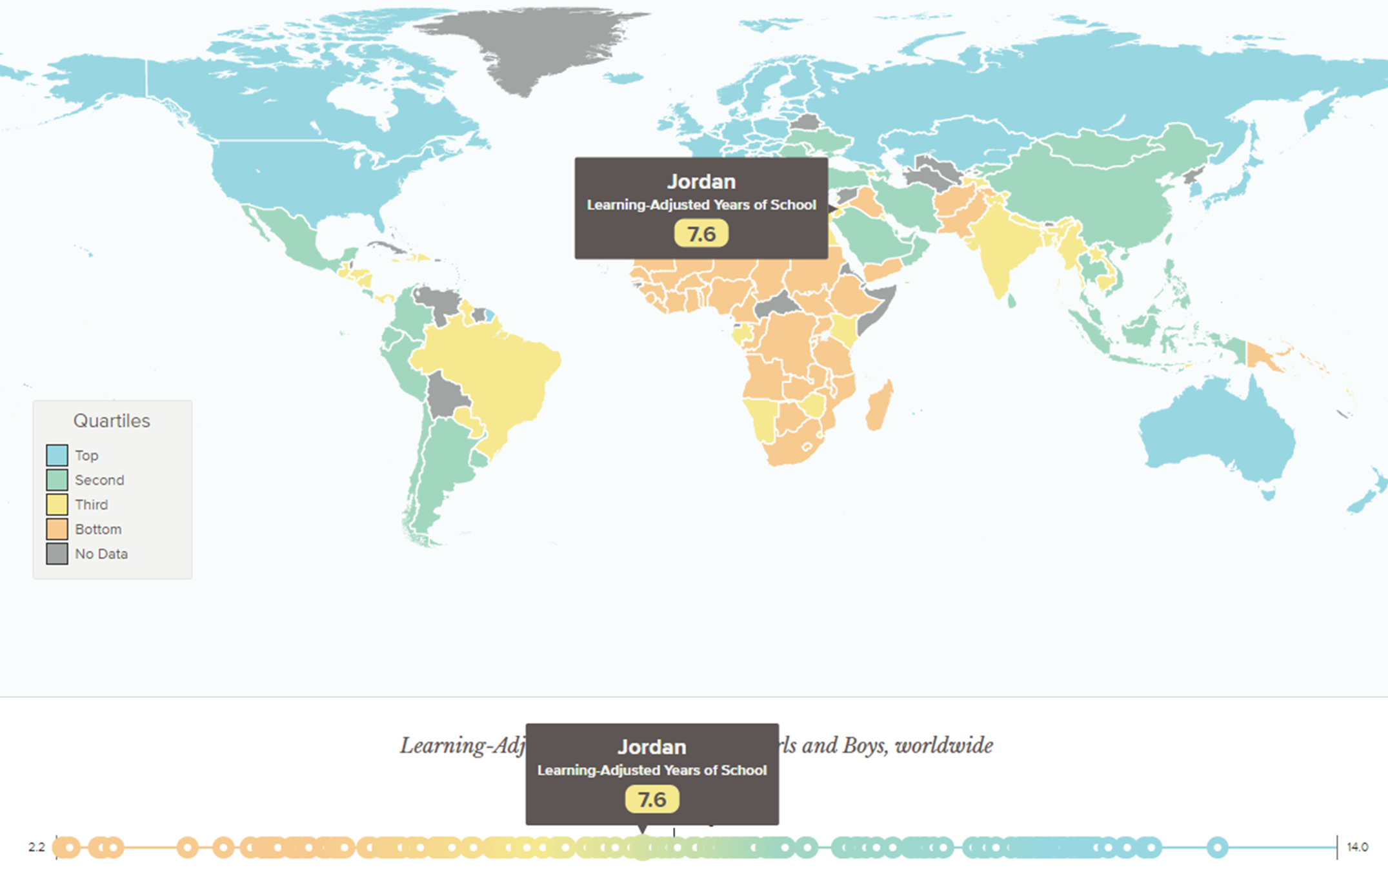

Learning disparities exacerbate schooling gaps
Learning disparities exacerbate schooling gaps
So what to do?
Madagascar
Learning Adjusted Years of School:
4.7

Slide 4





Learning disparities exacerbate schooling gaps
So what to do?
Especially in the context of COVID-19, in which…
Extended school closures deepen the learning crisis
Economic shocks precipitate budgetary constraints
Countries will need to spend smarter to build back better education systems and accelerate learning for all
Here is where the Global Education Policy Dashboard can help.

Slide 5
Goal: Measure and highlight the key drivers of learning outcomes

Slide 6
Our Framework

Slide 7

Our Framework
World Development Report 2018 (WDR)

Slide 8


Slide 9
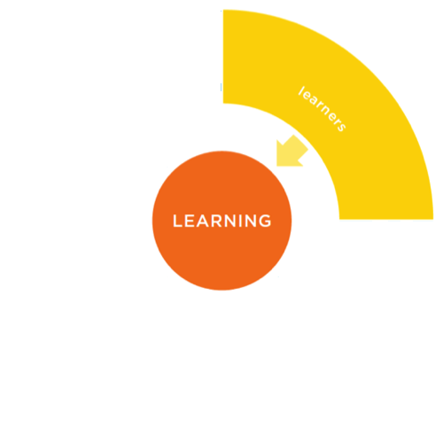

Slide 10
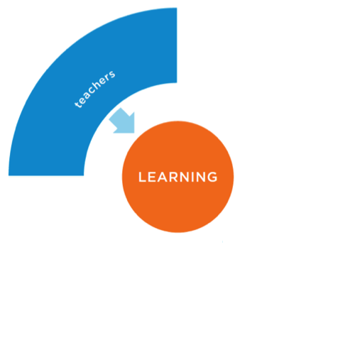

Slide 11
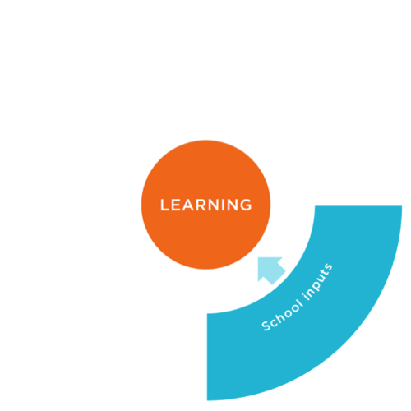

Slide 12
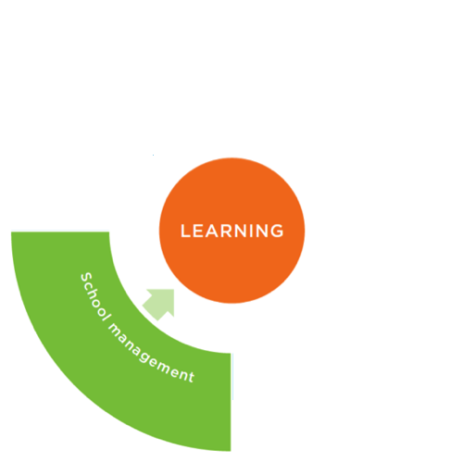
Practices

Slide 13
Policies
Practices

Slide 14
Politics
Policies
Practices

Slide 15
Financing
Characteristics of Bureaucracy
Impartial Decision-Making
Mandates & Accountability
National Learning Goals
Inputs & Infrastructure
Learners
Nutrition Programs
Standards
Basic Inputs
Readiness for Learning
Health Programs
Student Attendance
Early Childhood Education
Monitoring
Basic Infrastructure
Learning
Caregiver Skills Capacity
Caregiver Financial Capacity
School Management
Teaching
Core School Functions
Teachers’ Skills
Attraction
Clarity of Functions
Operational Management
Content Knowledge
Selection & Deployment
Instructional Leadership
Pedagogical Skills
Support
Attraction
Selection & Deployment
Managerial Skills
Evaluation
School Knowledge
Monitoring & Accountability
Support
Management Practices
Teacher Presence
Evaluation
Intrinsic Motivation

Slide 16
Our Methodology

Slide 17
Filling in the Global Education Policy Dashboard by
Identifying gaps in administrative systems, either because data are:
Not Collected
(E.g., school readiness)
Unreliable
(E.g., teacher presence)
Working with governments to collect new data, through:
School Survey
Policy Survey
Survey of Public Officials

Slide 18
A variety of sound tools are available to measure each of these indicators—
the Dashboard project brings them together to create a streamlined unified instrument.
Service Delivery Surveys (SDI)
1. School Survey
Practices
Classroom Observation Tool
Development World Management Survey
Child Development Measurement Tools

Slide 19
Policies
Policies
Service Delivery Surveys (SDI)
1. School Survey
Practices
Practices
Classroom Observation Tool
2. Policy Survey
Development World Management Survey
Child Development Measurement Tools
SABER Policy Measurement Tools

Slide 20
Politics
Policies
Service Delivery Surveys (SDI)
1. School Survey
Practices
Classroom Observation Tool
2. Policy Survey
Development World Management Survey
Child Development Measurement Tools
3. Survey of Public Officials
SABER Policy Measurement Tools
Bureaucracy Lab Survey

Slide 21
The value proposition of the GEPD
Three core instruments to report on a comprehensive set of indicators at low cost…
Integrating and streamlining proven tools, while leveraging innovations like…
And enabling the piloting of new tools through a menu of different options…
Inclusive education measures
School Survey
EdTech Readiness Index
EdTech measures
Socioemotional Assessment
Growth mindset & other socioemotional skill measures
Policy Survey
AMPL-B
School management
Ad-Hoc Country Surveys
Survey of Public Officials
Teach 2.0
Policy Implementation gaps
Socioeconomic Questionnaire
Bureaucratic Capacity

Slide 22
Some Highlights from Data Collected

Slide 23
3 Colors to Understand the System
Percentages – 0%-85%
Points – 1-3
Percentages – 85%-90%
Points – 3-4
Percentages – 90%-100%
Points – 4-5
Needs Improvement
Caution
On Target
- Current Thresholds - Based on information from Peru, Jordan, and Rwanda
- Possible Revisions - The Dashboard is being implemented in 11 more countries, and this may lead to revisions of the thresholds used in the future

Slide 24

Peru case - Shining light on learning and its drivers
Teaching
Learners
Content Knowledge
39% of teachers are proficient in the content they teach
Teacher skills (measured by direct observation and content assessment) and early capacity for learning (measured by direct assessment) stand out as the biggest problems
Readiness for Learning
53% of children have basic skills to succeed in primary
Pedagogical Practices
34% of teachers have satisfactory pedagogical skills
Student Attendance
93% of students are present during unannounced visit
Learning Poverty
56%
Teacher Presence
91% of teachers are present during unannounced visit
School Management
Inputs & Infrastructure
Operational Management
4.3 (out of 5) - Score on presence & quality of core operational functions
Basic Inputs
4.1 – Average basic inputs (out of 5) found in the typical school
Instructional Leadership
3.3 (out of 5) - Score on the presence & quality of instructional leadership
Electricity (98%)
Drinking water (91%)
Functioning Toilet (68%)
Accessibility (65%)
Internet (54%)
Basic Infrastructure
3.7 – Average basic infrastructure (out of 5) found in the typical school
School Knowledge
3.6 (out of 5) – Score on principals’ familiarity with the school
Management Skills
4.3 (out of 5) – Score on the quality of principals’ managerial skills

Slide 25
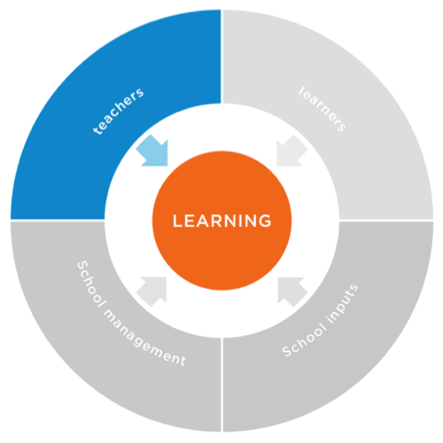
ECE
Coverage of ECE – 77%
ECE Classrooms with effective activities – 4%
Policies
Nutrition Programs
4.0
Practices
Health Programs
3.9
Readiness for Learning
52.7%
Early Childhood Education
1.6
Student attendance
93.0%
Policies
Caregiver Skills Capacity
2.3
Practices
Caregiver Financial Capacity
4.4

Slide 26

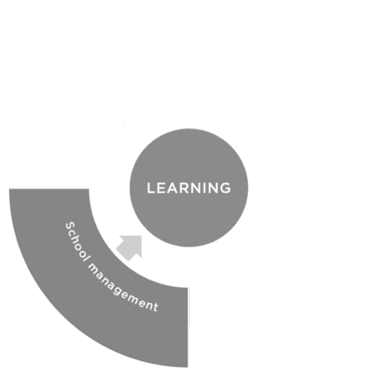
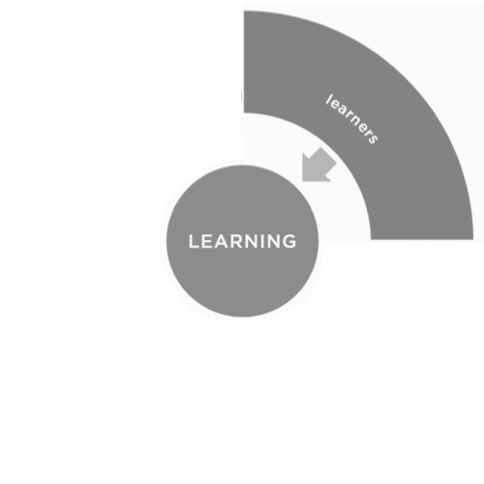
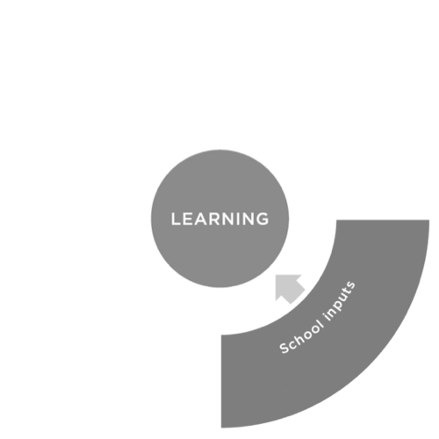
Understanding the Political and Bureaucratic Capacity of the system
Financing
4.7
Impartial Decision-Making
3.1
Mandates & Accountability
4.2
Characteristics of Bureaucracy
3.6
National Learning Goals
3.6
Politics
Policies
Practices
Impartial Decision-Making
National Learning Goals
Nonpoliticized policymaking – 3.8
Nonpoliticized policy implementation – 2.8
Nonpoliticized personnel management – 3.1
Employee unions as facilitators – 3.0
Targeting – 4.0
Monitoring – 3.9
Incentives – 2.9
Community engagement – 3.5

Slide 27
Financing
Characteristics of Bureaucracy
Impartial Decision-Making
Mandates & Accountability
National Learning Goals
Inputs & Infrastructure
Learners
Nutrition Programs
Standards
Basic Inputs
Readiness for Learning
Health Programs
Early Childhood Education
Monitoring
Basic Infrastructure
Learning
Student Attendance
Caregiver Skills Capacity
Caregiver Financial Capacity
School Management
Teaching
Core School Functions
Teachers’ Skills
Attraction
Clarity of Functions
Operational Management
Content Knowledge
Selection & Deployment
Instructional Leadership
Pedagogical Skills
Support
Attraction
Selection & Deployment
Managerial Skills
Evaluation
School Knowledge
Monitoring & Accountability
Support
Management Practices
Teacher Presence
Evaluation
Intrinsic Motivation

Slide 28
Practice Indicators: Peru, Jordan, Rwanda, Ethiopia, and Madagascar
Inputs & Infrastructure
Learners
Basic Inputs
Readiness for Learning
4.1
4.3
3.3
3.2
1.3
53%
37%
9%
35%
5%
Basic Infrastructure
Student Attendance
3.7
4.1
3.1
2.7
1.7
93%
97%
87%
77%
Peru Jordan Rwanda Ethiopia Madagascar
Peru Jordan Rwanda Ethiopia Madagascar
School Management
Learning Poverty
Core School Functions
56%
52%
90%
97%
Teaching
Operational Management
Peru Jordan Rwanda Ethiopia Madagascar
Content Knowledge
4.3
4.7
4
3.9
2.3
39%
34%
27%
6%
<1%
Instructional Leadership
Pedagogical Skills
3.3
3.3
3.4
3.9
2.7
34%
68%
22%
19%
Managerial Skills
Teacher Presence
School Knowledge
91%
93%
80%
66%
49%
3.6
3.8
4
3.3
3.4
Peru Jordan Rwanda Ethiopia Madagascar
Management Practices
4.3
4
4.2
4.2
3.5
Peru Jordan Rwanda Ethiopia Madagascar

Slide 29
The GEPD in [COUNTRY’S NAME]

Slide 30
Proposed Work
Funding – As part of the Accelerator Program, [COUNTRY’S NAME] has access to funding for two rounds of GEPD data collection
Data Collection - Gather data from 200 schools and 200 public officials
Stakeholder Validation – Once data is processed, validate findings with government
Data Publishing – Make data available through government platforms and through GEPD website (www.EducationPolicyDashboard.org)

Slide 31
Next Steps
Identify focal point for this engagement
Focal point to provide sampling frame for school and public official surveys
Clarify timeline, so WB can launch procurement of local survey firm
WB and focal point to work together on gathering necessary approvals (if any)

Slide 32



Thank you!

